Slide 1
PNUTS: Yahoo!’s Hosted Data Serving Platform
Naga Sirisha Sunkara
Vinay Santhosham
Venkatesh Ponduri
Vineeth Reddy Kottam

Slide 2
Introduction:
Massively parallel and geographically distributed database system for Yahoo’s web application.
It is a hosted and centrally managed service.
Data storage organized as hashed or ordered tables.

Slide 3
Requirements of a web application:
Scalability
Response time and geographic scope
High availability and fault tolerance
Relaxed consistency guarantees

Slide 4
Scalability:
Architectural scalability
Ability to scale during periods of rapid growth
Minimal optimal effort
Minimal impact on system performance

Slide 5
Response time and geographic scope:
Fast response time to geographically distributed users
It should not vary even under flash crowds ,denial of service attacks, etc.,

Slide 6
High Availability and Fault Tolerance:
High degree of availability
Application specific trade offs in the degree of fault tolerance
Must be able to read and write in case of failures.

Slide 7
Relaxed Consistency:
Tradeoff between performance and availability on one hand and consistency on the other.
Eventual consistency updates one replica first and then others.
Eventual consistency is weak and inadequate for web applications.

Slide 8
PNUTS Overview:
Data Model and features.
Fault Tolerance
Pub-Sub Message System
Record Level Mastering
Hosting

Slide 9
Data Model and Features:
Simple relational model to users.
Supports single table scans with predicates.
Scatter-gather operations
Asynchronous notification of clients
Bulk Loading
Fault Tolerance:
Highly available reads and writes even after a failure

Slide 10
Pub–Sub Message System:
Operations are done on topic based pub/sub system called Yahoo Message Broker(YMB).
YMB with PNUTS is a part of Yahoo’s Sherpa data services platform.
Record Level Mastering:
Asynchronous high latency operations.
Hosting:
Centrally managed database service shared by multiple applications.

Slide 11
Functionality:
Data and query model
Consistency model
Notification
Bulk loading

Slide 12
Data and Query Model
PNUTS presents a simplified relational data model to the user.
Data is organized into tables of records with attributes
Schemas are flexible.
The query language of PNUTS supports selection and projection from a single table.
Updates and deletes must specify the primary key.

Slide 13
Data and Query Model
This system is designed primarily for online serving workloads that consist mostly of queries that read and write single records or small groups of records.
Missing Features :
It does not enforce constraints such as referential integrity, although this would be very desirable.
Another missing feature is complex ad hoc queries (joins, group-by, etc.).

Slide 14
Consistency Model: Hiding the Complexity of Replication
This model stems from the earlier observation that web applications typically manipulate one record at a time.
We provide per-record timeline consistency: all replicas of a given record apply all updates to the record in the same order.

Slide 15

Consistency Model: Hiding the Complexity of Replication
Example sequence of updates to the records :
In this diagram, the events on the timeline are inserts, updates and deletes for a particular primary key.
The record carries a sequence number that is incremented on every write.
As shown in the diagram, the sequence number consists of the generation of the record and the version of the record.

Slide 16
Consistency Model: Hiding the Complexity of Replication
Using this per-record timeline consistency model, This system supports whole range of API calls with varying levels of consistency guarantees.
Read- any :
Returns a possibly stale version of the record.
However, the returned record is always a valid one from the record’s history.
Lower latency
Performance matters most than consistency

Slide 17
Consistency Model: Hiding the Complexity of Replication
2. Read-critical(required version):
Returns a version of the record that is strictly newer than, or the same as the required version.
3. Read-latest:
Returns the latest copy of the record that reflects all writes that have succeeded.

Slide 18
Consistency Model: Hiding the Complexity of Replication
4. Write:
This call gives the same ACID guarantees as a transaction with a single write operation in it.
This call is useful for blind writes, e.g., a user updating his status on his profile.
5. Test-and-set-write(required version):
This call performs the requested write to the record if and only if the present version of the record is the same as required version.

Slide 19
Consistency Model: Hiding the Complexity of Replication
Future Implementations:
Bundled updates:
Relaxed consistency:

Slide 20
Notification
Trigger-like notifications are important for applications such as ad serving, which must invalidate cached copies of ads when the advertising contract expires.
Accordingly, we allow the user to subscribe to the stream of updates on a table.

Slide 21
Bulk Load
Bulk loading tools are necessary for applications such as comparison shopping, which upload large blocks of new sale listings into the database every day.
Bulk inserts can be done in parallel to multiple storage units for fast loading.
In the hash table case, the hash function naturally load balances the inserts across storage units.

Slide 22
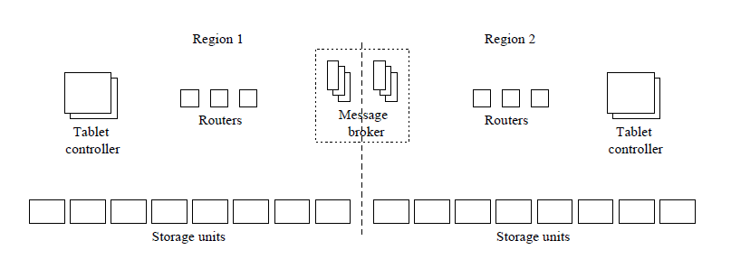
PNUTS SYSTEM ARCHITECTURE

Slide 23
PNUTS SYSTEM ARCHITECTURE
A key feature of PNUTS is the use of a pub/sub mechanism for both reliability and replication.
In fact, our system does not have a traditional database log or archive data.
Instead, we rely on the guaranteed delivery pub/sub mechanism to act as our redo log, replaying updates that are lost before being applied to disk due to failure.
The replication of data to multiple regions provides additional reliability, obviating the need for archiving or backups.

Slide 24
DATA STORAGE AND RETRIEVAL
Data tables are horizontally partitioned into groups of records called tablets.
Tablets are scattered across many servers.
The assignment of tablets to servers is flexible.
Three components in architecture diagram are primarily responsible for managing and providing access to data tablets.
The storage unit
The router and
The tablet controller

Slide 25
DATA STORAGE
Storage units store tablets
Responds to get()
scan()
set()
Updates are committed by first writing them to the message broker.
For hash tables, our implementation uses a UNIX filesystem-based hash table implemented originally for Yahoo!’s user database.
For ordered tables, we use MySQL with InnoDB because it stores records ordered by primary key.

Slide 26
ROUTER
Determines which tablet contains the record, and then determine which storage unit has that tablet.
This storage unit is responsible for a given record to be read or written by the client.
The router stores an interval mapping, which defines the boundaries of each tablet, and also maps each tablet to a storage unit.

Slide 27
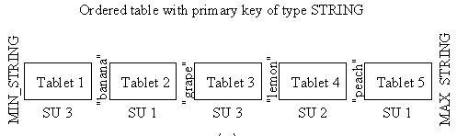
FOR ORDERED TABLE…
For ordered tables, the primary-key space of a table is divided into intervals, and each interval corresponds to one tablet.
This mapping is similar to a very large root node of a B+ tree.
Binary search

Slide 28
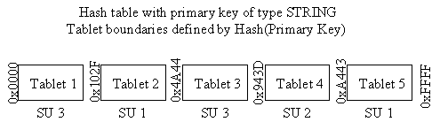
FOR HASHED TABLE….
For hash-organized tables, we use an n-bit hash function H() that produces hash values 0 <= H() < 2n. The hash space [0...2n) is divided into intervals, and each interval corresponds to a single tablet.
Hash the key
Binary search
Same code to maintain and search interval mappings for both hash and ordered tables.

Slide 29
TABLET CONTROLLER
Routers contain only a cached copy of the interval mapping.
The mapping is owned by the tablet controller.
Moves tablet
updates the authoritative copy of the mapping
Routers mapping outdate lead to retrieve newone from TC.
The primary bottleneck in our system is disk seek capacity on the storage units and message brokers.
Customers can share routers and tablet controllers.
In the future, all customers should be able to share all components.

Slide 30
Replication and Consistency
PNUTS uses asynchronous replication to ensure low- latency updates.
Uses the Yahoo! message broker, a publish/subscribe system developed at Yahoo!, both as our replacement for a redo log and as our replication mechanism.

Slide 31
Yahoo! Message Broker
Yahoo! Message Broker (YMB) is a topic-based pub/sub system, which together with PNUTS, is part of Yahoo!’s Sherpa data services platform.
Data updates are considered “committed” when they have been published to YMB. At some point after being committed, the update will be asynchronously propagated to different regions and applied to their replicas.

Slide 32
Why Yahoo Message Broker ?
We use YMB for replication and logging for two reasons.
First, YMB takes multiple steps to ensure messages are not lost before they are applied to the database.
YMB guarantees that published messages will be delivered to all topic subscribers even in the presence of single broker machine failures.
Second, YMB is designed for wide-area replication: YMB clusters reside in different, geographically separated datacenters, and messages published to one YMB cluster will be relayed to other YMB clusters for delivery to local subscribers.
This mechanism isolates individual PNUTS clusters from dealing with update propagation between regions.

Slide 33
How YMB Works ?
YMB provides partial ordering of published messages. Messages published to a particular YMB cluster will be delivered to all subscribers in the order they were published.
However, messages published to different YMB clusters maybe delivered in any order.
In order to provide time- line consistency, developed a per-record mastership mechanism, and the updates published by a record’s master to a single YMB cluster are delivered in the published order to other replicas.

Slide 34
Consistency via YMB and mastership
Per-record timeline consistency is provided by designating one copy of a record as the master, and directing all up- dates to the master copy.
In this record-level mastering mechanism, mastership is assigned on a record-by-record basis, and different records in the same table can be mastered in different clusters.
This mechanism is used because it is observed significant write locality on a per-record basis in web workloads.

Slide 35
Consistency via YMB and mastership
All updates are propagated to non-master replicas by publishing them to the message broker, and once the update is published we treat it as committed.
A master publishes its updates to a single broker, and thus updates are delivered to replicas in commit order.
Because storage units are so numerous, we prefer to use cheaper, commodity servers in- stead of expensive, highly reliable storage.

Slide 36
Recovery
Recovering from a failure involves copying lost tablets from another replica. Copying a tablet is a three step process.
First, the tablet controller requests a copy from a particular remote replica (the “source tablet”).
Second, a “checkpoint message” is published to YMB, to ensure that any in-flight updates at the time the copy is initiated are applied to the source tablet.
Third, the source tablet is copied to the destination region.
To support this recovery protocol, tablet boundaries are kept synchronized across replicas, and tablet splits are conducted by having all regions split a tablet at the same point (coordinated by a two-phase commit between regions).

Slide 37
Conclusion
PNUTS focus is on data serving for web applications, rather than complex queries and with intention of not loosing the data.

Slide 38


